Slide 1
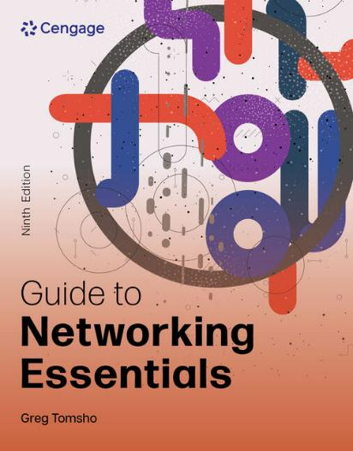
Guide to Networking Essentials, 9e
Chapter 1: Introduction to Computer Networks
.

Slide 2
Icebreaker: Interview Simulation
The class will be broken up into pairs of students.
Each pair of students will interview each other to discover interesting or unusual facts.
Then each pair will introduce each other to the class.
Think about connecting a story from your personal experiences to topics that are relevant to this course.

Slide 3
Chapter Objectives
By the end of this chapter, you should be able to:
Describe basic computer concepts, components, and operation
Explain the fundamentals of network communication
Define common networking terms
Compare different network models

Slide 4
An Overview of Computer Concepts
Most devices found on networks are workstations and network servers
It also includes routers and switches, which are specialized computers used to move data from computer to computer and network to network
Nontraditional computers include:
Smartphones, smart watches, home assistants like Amazon Echo and Google Home, and smart “things” such as appliances, and thermostats
Smart things are collectively referred to as Internet of Things (IoT) devices

Slide 5
Basic Functions of a Computer
A computer’s functions can be broken down into the following tasks:
Input: A user types the letter ‘A’ on the keyboard, which results in sending a code representing the letter ‘A’ to the computer
Processing: The computer’s CPU determines what letter was typed by looking up the keyboard code in a table
Output: The CPU sends instructions to the graphics cards to display the letter ‘A’, which is then sent to the computer monitor
Some computer components are designed to perform only one of these three functions
https://www.yout-ube.com/watch?v=nt0xqeHmWBY (Intro to Networking)

Slide 6
Input Components
Input components include the following:
User controlled devices such as keyboards, microphones, Webcams, and scanners
External interfaces, such as serial, FireWire, and USB ports can also be used to get input from external devices.
Input is also generated by storage devices such as hard disks and CDs/DVDs
Inputs to a computer can include timers that cause programs to run periodically

Slide 7
Processing Components
The central processing unit (CPU) is a computer’s main processing component
A graphics processing unit (GPU) is the processor on a graphics card that handles many complex calculations, improving system performance
Current CPUs are composed of two or more processors called cores
A multicore CPU is like a person with two brains
Multicore CPUs enable computers to carry out multiple instructions simultaneously, which results in better overall performance

Slide 8
Output Components
Output components include monitors and printers
They also include storage devices, network cards, and sound cards
External interfaces mentioned previously as input components can be used as output components
For example, a disk drive connected to a USB port allows reading files from the disk (input) and writing files to the disk (output)

Slide 9
Storage Components (1 of 4)
The more storage a computer has, the better the performance
Most storage components are both input and output devices
Most people think of storage as disk drives, CD/DVD drives, and USB flash drives
The following are two main categories of storage:
Short-term storage
Long-term storage

Slide 10
Storage Components (2 of 4)
When data in storage is not maintained when power is turned off, it is known as short-term storage
Random Access Memory (RAM) is short-term storage
The amount of RAM in a computer is crucial to the computer’s capability to operate efficiently
RAM is also referred to as “working storage”
If there’s not enough RAM to run a program, the computer will use the disk drive to supplement
Temporary use of the disk drive is not optimal because RAM is thousands of times faster than the fastest disk drives

Slide 11
Storage Components (3 of 4)
Data on a computer is stored as binary digits (“bits” for short)
A bit holds a 1 or 0 value
A pulse of 5 volts of electricity can represent a 1 bit and a pulse of 0 volts (the absence of voltage) can represent a 0 bit
With fiber-optic cable, a 1 bit is represented by the presence of light and a 0 bit by the absence of light
A byte is a collection of 8 bits
Table 1-1 on the following slide shows prefixes used for expressing bits and bytes

Slide 12
Storage Components (4 of 4)
Table 1-1 Prefixes used for expressing bits and bytes
Prefix | Value
Kilo (K) | Thousand (10³)
Mega (M) | Million (10⁶)
Giga (G) | Billion (10⁹)
Tera (T) | Trillion (10¹²)
Peta (P) | Quadrillion (10¹⁵)
Exa (E) | Quintillion (10¹⁸)
Zeta (Z) | Sextillion (10²¹)
Yotta (Y) | Septillion (10²⁴)

Slide 13
Personal Computer Hardware (1 of 5)
Four major PC components include the following:
Motherboard
Storage device
RAM
Firmware
The Motherboard and Its Components
The motherboard is a network of wires and controlling circuits that connects all computer components

Slide 14
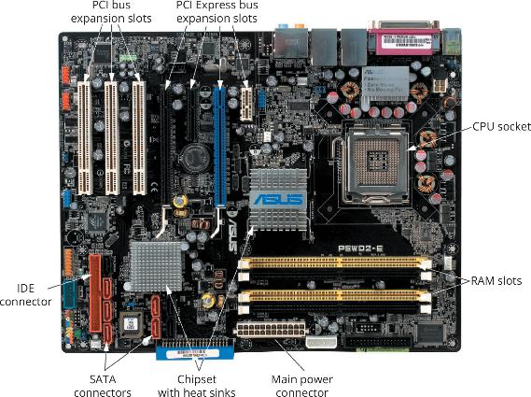
Personal Computer Hardware (2 of 5)
Figure 1-1 A PC motherboard

Slide 15
Personal Computer Hardware (3 of 5)
Computer Bus Fundamentals
A bus is a collection of wires carrying data from one place to another on the computer
All data that goes into or comes out of a computer goes through the motherboard
There are buses between:
CPU and RAM
CPU and disk drives
CPU and expansion slots

Slide 16
Personal Computer Hardware (4 of 5)
A hard drive is the primary long-term storage component on a system
It consists of magnetic disks called “platters” that store data in the form of magnetic pulses
Solid State Drives (SSDs) are used in place of hard drives due to speed and reliability
SSDs use flash memory, so, it contains no moving parts and has faster access times
RAM is the main short-term storage component on a computer
RAM requires continuous power to store data (volatile memory)

Slide 17
Personal Computer Hardware (5 of 5)
Firmware is a computer program stored in nonvolatile memory such as ROM or flash memory
Located on the motherboard and is executed when the computer is powered on
Firmware on most PCs is called the basic input/output system (BIOS) or Unified Extensible Firmware Interface (UEFI)
Instructs the computer to perform a power-on self test (POST)
Configuration data is stored in a type of memory called complementary metal oxide semiconductor (CMOS)

Slide 18
Computer Boot Procedure
To take a computer from a powered-off state to running an OS, the following steps must take place:
Power is applied to the motherboard
The CPU starts
The CPU carries out the firmware startup routines, including the POST
Boot devices, as specified in the firmware configuration, are searched for an OS
The OS is loaded into RAM
OS services are started

Slide 19
The Fundamentals of Network Communication
A computer network consists of two or more computers connected by some kind of transmission medium
Such as a cable or air waves
In order to access the Internet, a computer has to be able to connect to a network
The next few slides will cover what is required to turn a stand-alone computer into a networked computer

Slide 20
Network Components (1 of 2)
Hardware components needed to turn a stand-alone computer into a networked computer include the following:
A network interface card provides a connection between the computer and the network
Network medium is a cable that plugs into the NIC and makes the connection between a computer and the rest of the network
Network media can also be the electromagnetic waves, as in wireless networks
An interconnecting device allows two or more computers to communicate on the network without having to be connected directly to one another

Slide 21
Network Components (2 of 2)
Network software can include the following:
Network client software requests information stored on another network computer or device
Network server software allows a computer to share its resources
Network protocols define the rules and formats a computer must use when sending information across the network
NIC drivers receive data from protocols and forward this data to the physical NIC

Slide 22
Steps of Network Communication
Application tries to access a network resource by sending a message
Client software formats the message and passes the message on to the network protocol
Protocol packages the message in a format suitable for the network and sends it to the NIC driver
The NIC driver sends data in the request to the NIC card to be converted into necessary signals to be transmitted on the network
Steps taken at the server side are essentially the reverse of those on the client side

Slide 23
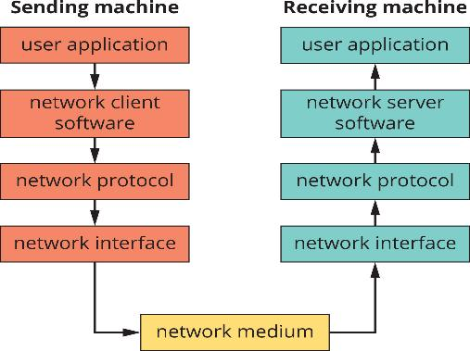
Layers of the Network Communication Process
Figure 1-7 Layers of the network communication process

Slide 24
How Two Computers Communicate on a LAN: Some Details (1 of 2)
TCP/IP is the most common protocol (language) used on networks
TCP/IP uses 2 addresses to identify devices:
Logical address (IP address)
Physical address (MAC address)
Just as a mail person needs an address to deliver mail, TCP/IP needs an address in order to deliver data to the correct device on a network
Think of the logical address as a zip code and the physical address as a street address

Slide 25
How Two Computers Communicate on a LAN: Some Details (2 of 2)
A user at Comp A types ping 10.1.1.2 at a command prompt
Comp A performs a name lookup to retrieve Comp B’s IP address
Network software creates a ping message
The network protocol adds the IP address of sending and destination computers and acquires the destination computer’s MAC address
The network interface software adds MAC addresses of sending and destination computers
Comp B receives message, verifies that the addresses are correct and then sends a reply to Comp A using Steps 3 – 5

Slide 26
Knowledge Check Activity 1-1
If you want to have fast long-term storage on your laptop computer, which of the following types of storage should you use to get the fastest performance?
RAM
Hard drive
Solid state drive
DVD drive

Slide 27
Knowledge Check Activity 1-1: Answer
If you want to have fast long-term storage on your laptop computer, which of the following types of storage should you use to get the fastest performance?
Answer: c. Solid state drive
Explanation: Of the long-term storage types listed, the solid state drive (SSD) provides the fastest performance. RAM is the fastest type of storage of those listed but it is short-term storage.

Slide 28
LANs, Internetworks, WANs, and MANs (1 of 3)
A local area network (LAN) is a small network, limited to a single collection of machines and connected by one or more interconnecting devices in a small geographic area
An internetwork is a networked collection of LANs tied together by devices such as routers
Wide area networks (WANs) use the services of third-party providers to carry network traffic from one location to another
Metropolitan area networks (MANs) use WAN technologies to interconnect LANs in a specific geographic region, such as a county or city

Slide 29
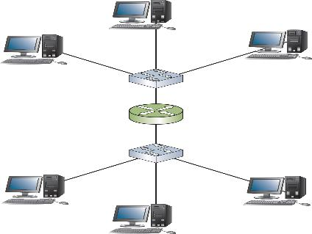
LANs, Internetworks, WANs, and MANs (2 of 3)
Figure 1-17 An internetwork with two LANs connected by a router

Slide 30
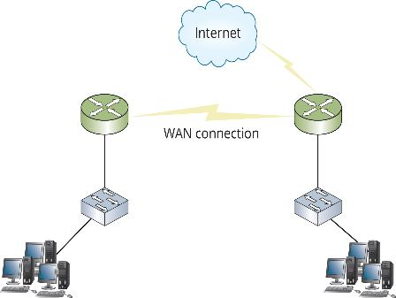
LANs, Internetworks, WANs, and MANs (3 of 3)
Figure 1-18 A WAN with a connection to the Internet

Slide 31
WLANs, CANs, and PANs (1 of 2)
A wireless LAN (WLAN) consists of network devices and an interconnecting device called an access point
A campus area network (CAN) is an internetwork that spans a limited area confined to a college campus or corporate campus
They use mostly LAN technologies
A personal area network (PAN) uses short-range wireless technology to connect personal devices such as smartphone, tablet, or laptop, to other devices like a smart watch, and wireless ear buds

Slide 32
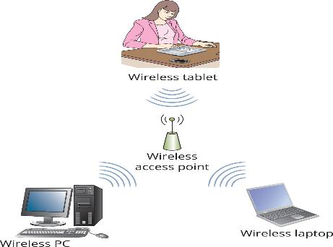
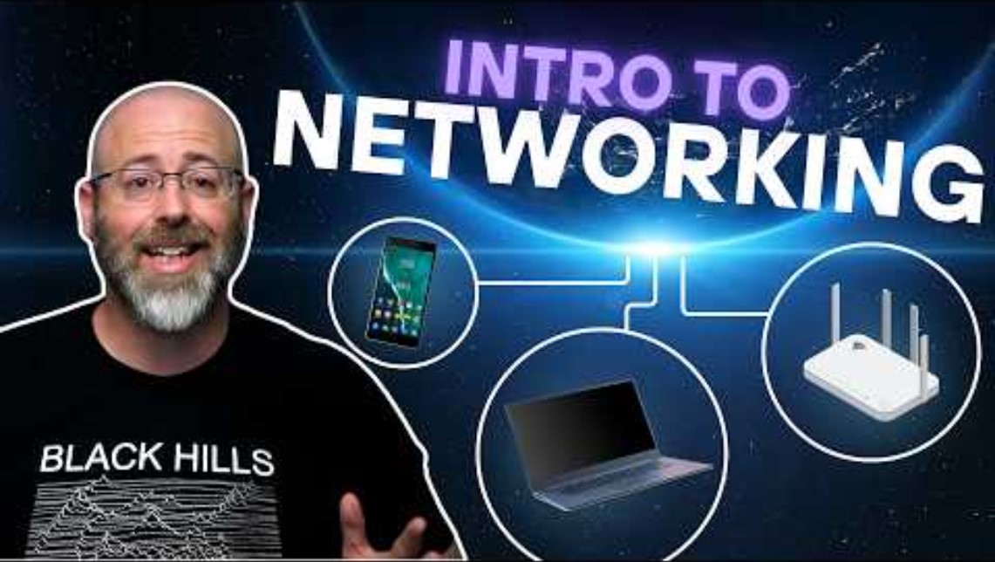
WLANs, CANs, and PANs (2 of 2)
https://www.yout-ube.com/watch?v=nt0xqeHmWBY
Figure 1-19 A wireless LAN

Slide 33
Internet, Intranet, and Extranet
The Internet is a worldwide public internetwork that uses protocols such as TCP/IP and HTTP to transfer and view information
An intranet is a private internetwork in which devices and servers are only available to those users connected to the internal network
An extranet allows limited and controlled access to internal resources by outside users

Slide 34
Packets and Frames (1 of 2)
Computers transfer information across networks in shorts bursts of about 1500 bytes of data
Reasons data is transferred this way include the following:
Pause between bursts allows other computers to transfer data during pauses
Allows the receiving computer to process received data
The receiving computer can receive other data at the same time
Gives the sending computer an opportunity to receive data from other computers and perform other processing tasks

Slide 35
Packets and Frames (2 of 2)
A packet is a chunk of data with a source and destination IP address added to it
A frame is a packet with the source and destination MAC addresses added to it
The packet is “framed” by the MAC addresses on one end and an error-checking code on the other
The process of adding IP addresses and MAC addresses to chunks of data is called encapsulation
Information added to the front of the data is called a header and information added to the end is called a trailer

Slide 36
Clients and Servers (1 of 2)
A client can be a workstation running a client OS or it can refer to the network software on a computer that requests network resources from a server
The word “client” is usually used in these three contexts:
Client operating system—The OS installed on a computer
Client computer—Its primary role is to run user applications and access network resources
Client software—The software that requests network resources from server software on another computer

Slide 37
Clients and Servers (2 of 2)
A computer becomes a server when software is installed on it that provides a network service to client computers
The term “server” is also used in three contexts:
Server operating system—The OS installed on a computer designed to share network resources and provide other network services
Server computer—This computer’s primary role in the network is to give client computers access to network resources and services
Server software—The software that responds to requests for network resources from client software

Slide 38
Network Models
A network model defines how and where resources are shared and how access to these resources is regulated
Network models fall into two major types:
In a peer-to-peer network, most computers function as clients or servers (no centralized control over who has access to network resources)
In a server-based network, certain computers take on specialized roles and function mainly as servers, and ordinary users’ machines tend to function mainly as clients

Slide 39
Peer-to-Peer/Workgroup Model (1 of 2)
Computers on a peer-to-peer network can take both a client and a server role
Any user can share resources on his/her computer with any other user’s computer
Every user must act as the administrator of his/her computer
They can give everyone else unlimited access to their resources or grant restricted access to other users
Usernames and passwords (credentials) are used to control that access

Slide 40
Peer-to-Peer/Workgroup Model (2 of 2)
Problems with peer-to-peer networks include the following:
Users must remember multiple sets of credentials to access resources on several computers
Desktop PCs and the OS installed on them aren’t made to provide network services as efficiently as dedicated network servers
Data organization
If every machine can be a server, how can users keep track of what information is stored on which machine?

Slide 41
Server/Domain-Based Model (1 of 5)
Server-based networks allow centralized control over network resources
Users log on to the network with a single set of credentials maintained by one or more servers running a server OS
In most cases, servers are dedicated to running network services and should not be used to run user applications
A domain is a collection of users and computers whose accounts are managed by Windows servers called domain controllers

Slide 42
Server/Domain-Based Model (2 of 5)
Users and computers in a domain are subject to network access and security policies defined by a network administrator
The software that manages this security is referred to as a directory service
On Windows servers, the directory service software is Active Directory

Slide 43
Server/Domain-Based Model (3 of 5)
Other network services found on network servers:
Naming services—Translate computer names to their address
E-mail services—Manage incoming and outgoing email
Application services—Grant client computers access to complex applications that run on the server
Communication services—Give remote users access to a network
Web services—Provide comprehensive Web-based application services

Slide 44
Server/Domain-Based Model (4 of 5)
Server-based networks are easier to expand than peer-to-peer
Peer-to-peer should be limited to 10 or fewer users
Server-based networks can handle up to thousands of users
Multiple servers can be configured to work together which can be used to run a more efficient network or can provide fault tolerance

Slide 45
Server/Domain-Based Model (5 of 5)
Table 1-5 Peer-to-peer versus server-based networks
Network attribute | Peer-to-peer network | Server-based network
Resource access | Distributed among many desktop/client computers, makes access to resources more complex | Centralized on one or more servers; streamlines access to resources
Security | Users control their own shared resources and might have several sets of credentials to access resources; not ideal when tight security is essential | Security is managed centrally, and users have a single set of credentials for all shared resources; best when a secure environment is necessary
Performance | Desktop OS not tuned for resource sharing; access to shared resources can be hindered by users running applications | Server OS tuned for resource sharing; servers are usually dedicated to providing network services
Cost | No dedicated hardware or server OS required, making initial costs lower; lost productivity caused by increasing complexity can raise costs in the long run | Higher upfront costs because of dedicated hardware and server OSs; additional ongoing costs for administrative support

Slide 46
Knowledge Check Activity 1-2
Which type of software are you most likely to find only on a server OS as opposed to a client OS?
File sharing software
Directory service software
Printer sharing software
Word processing software

Slide 47
Knowledge Check Activity 1-2: Answer
Which type of software are you most likely to find only on a server OS as opposed to a client OS?
Answer: b. Directory service software
Explanation: Client OSs commonly include file and printer sharing software so resources can be shared in a peer-to-peer network. They usually also have word processing software. But a client OS is unlikely to have directory service software such as Active Directory; directory service software is usually only found on server OSs such as Windows Server.

Slide 48
Self Assessment
Name the differences between short-term storage versus long-term storage.
Use Table 1-5 from the text to familiarize yourself with the differences between peer-to-peer versus server-based networks. Which type of network would be best for a company with 3 users?

Slide 49
Summary
Now that the lesson has ended, you should be able to:
Describe basic computer concepts, components, and operation
Explain the fundamentals of network communication
Define common networking terms
Compare different network models

